Slide 1
Unit 202: Principles of electrical science
Power

Slide 2
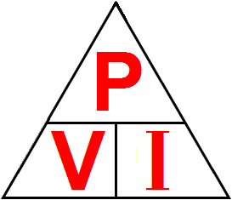
Power
Electrical power is the rate of doing electrical work or of expenditure of electrical energy.
The formula for Power is obtained by using the power triangle, as shown on the right.
From the triangle it can be seen that:
Power | = | Volts × Amps
or
P | = | V.I (d.c. only)

Slide 3
Power
Since Ohm’s law is: V = I × R, by substituting I × R for V in the power equation, we get: P = I × I × R giving:
P | = | I²R
(a.c. or d.c.)
Since Ohm’s Law is: I = V/R, by substituting V/R for I in the power equation, we get: P = V/R × V giving:
P | = | V² R
(a.c. or d.c.)

Slide 4
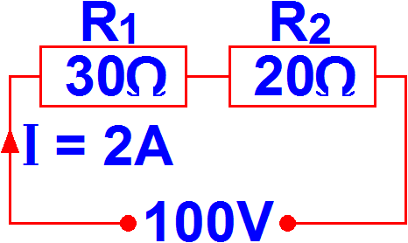
Example 1
Calculate the power in each resistance and the total power taken by the circuit.
Total power | = | V × I
 | = | 100 × 2
 | = | 200 watts
Power dissipated by R₁ = P₁:
P₁ | = | I²R₁
 | = | 2² × 30
 | = | 120 watts
Power dissipated by R₂ = P₂:
P₂ | = | I²R₂
 | = | 2² × 20
 | = | 80 watts

Slide 5
Example 1
Total power | = | P₁ + P₂
 | = | 120 + 80
 | = | 200 watts
Proving that when all the individuals powers in a circuit are added together, they will equal the total power in the circuit. This applies for both series and parallel circuits.

Slide 6
Example 1
Alternatively, since:
V | = | I × R
then voltage across R₁ is V₁:
V₁ | = | I × R₁
 | = | 2 × 30
 | = | 60 volts
P₁ | = | V₁²
 |  | R₁
P₁ | = | V₁ × I
or
 | = | 60²
 |  | 30
 | = | 60 × 2
 | = | 120 watts
 | = | 120 watts

Slide 7
Example 1
Similarly, voltage across R₂ is V₂:
V₂ | = | I × R₂
 | = | 2 × 20
 | = | 40 volts
P₂ | = | V₂²
 |  | R₂
P₂ | = | V₂ × I
or
 | = | 40²
 |  | 20
 | = | 40 × 2
 | = | 80 watts
 | = | 80 watts

Slide 8
Unit 202: Principles of electrical science
The End

